Slide 1

Gas Price Movement
March 31, 2022

Slide 2


Petrojam prices
WEEKLY GAS PRICE REVIEW
87 Octane prices increased by 2.33% (JMD$4.35) this week to JMD$191.33. The gas price opened the year 2022 at J$167.42 and increased by JMD$23.91 year to date.
90 Octane price increased by 2.28% (JMD$4.37) this week to JMD$196.35. The gas price open the year 2022 at JMD$172.88 and rose by JMD$23.47 year to date.
Diesel price increased by 2.34% (JMD$4.50) this week to JMD$196.95. The gas price open the year 2022 at JMD$162.42 and increased by JMD$34.53 year to date.

Slide 3

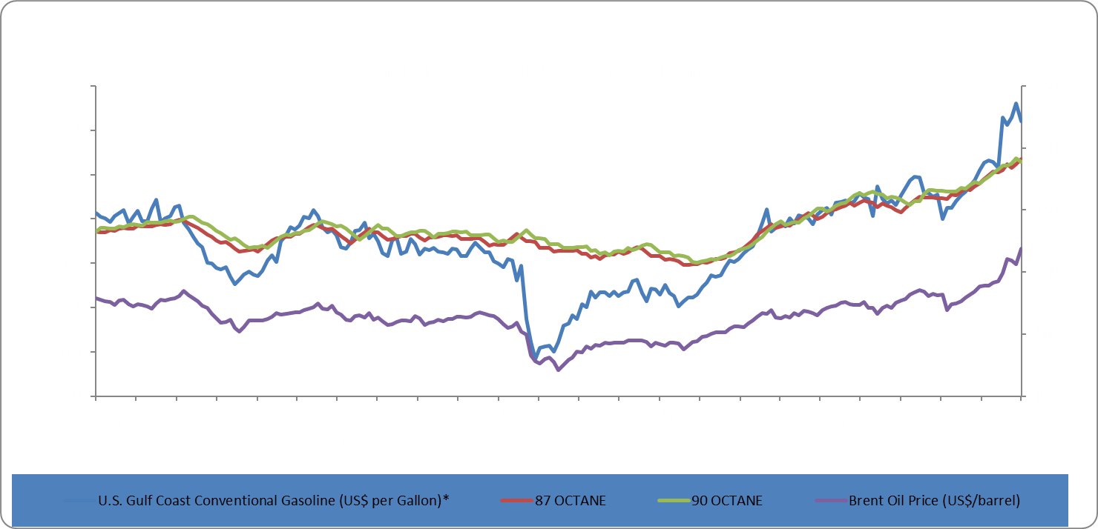
Brent Oil
Brent oil prices decreased by 9.34% or US$11.12 relative to the prior week. Oil traded on March 31, 2022, at US$107.91 per barrel relative to US$119.03 on March 24, 2021. Brent oil opened 2022 year at US$78.98 per barrel and has increased by US$28.93 (36.63%) year to date.
WEEKLY GAS PRICE REVIEW

Slide 4
This Week in Petroleum
U.S. average regular gasoline prices decrease and diesel prices increase
On March 28, 2022, the U.S. average regular gasoline retail price decreased by nearly 1 cent, to $4.23 per gallon on, $1.38 higher than a year ago. The East Coast price decreased by less than 4 cents to $4.09 per gallon and the Gulf Coast price decreased by less than 6 cents to $3.88 per gallon. The West Coast price increased by less than 5 cents to $5.27 per gallon, The Midwest price increased by nearly 2 cents to $4.05 per gallon, and the Rocky Mountain price increased by nearly 6 cents to $4.17 per gallon.
The average diesel fuel price increased by nearly 5 cents to $5.19 per gallon on March 28, $2.02 higher than a year ago. The Rocky Mountain price increased by less than 16 cents to $5.04 per gallon, the Midwest price increased by less than 4 cents to $4.99 per gallon, the East Coast price increased by 7 cents to $5.18 per gallon, The Gulf Coast price increased by less than 1 cent to $4.97 per gallon and the West Coast price increased by 8 cents to $5.87 per gallon.
WEEKLY GAS PRICE REVIEW

Slide 5
This Week in Petroleum con’t
Inventories for propane/propylene decline
There was a decrease in U.S. propane/propylene stocks last week by nearly 0.15 million barrels to 33.71 million barrels as of March 25, 2022, 5.54 million barrels less than the (2021) average inventory levels a year ago.
Additionally, Gulf Coast and Rocky Mountain/West Coast inventories fell by 0.129 million, 0.035 million barrels, respectively. East Coast and Midwest, inventories increased by 0.145 million barrels and 0.52 million barrels, respectively.
For additional information click the link below:
https://www.eia.gov/petroleum/weekly/propane.php
WEEKLY GAS PRICE REVIEW

Slide 6

This Week in Petroleum con’t
U.S Energy noted, “on February 24, 2022, Russia’s further invasion of Ukraine contributed to a significant increase in the Brent crude oil price, which rose to $134 per barrel (b) as of March 8. This price increase reflects increased geopolitical risk and uncertainty regarding how announced and potential future sanctions may affect energy markets.” Additionally, on March 8, the United States, United Kingdom, and European Union all announced some measure of eliminating or limiting imports of energy commodities from Russia, pushing crude oil prices up further.
Furthermore, “a number of western energy companies, including ExxonMobil, Shell, BP, and Equinor, have announced that they are stopping operations in Russia and ending partnerships with Russian firms. Trade press also reports that a number of European refiners, shippers, and insurance companies are not purchasing or shipping crude oil from Russia.”
It is estimated that Russia’s production of petroleum and other liquids averaged 11.3 million barrels per day in February 2022, and given recent reports, it is expected that production in Russia will fall by 0.3 million b/d in March and fall an additional 0.5 million b/d in April. We assume that Russian crude oil exports will decrease during the coming months, and, in turn, production. As Russian crude oil exports decrease, onshore storage likely will fill up quickly because of limited onshore storage capacity, which will prompt production shut-ins and floating storage on ships.
WEEKLY GAS PRICE REVIEW

