Slide 1

Gas Price Movement
December 15, 2022

Slide 2


Petrojam Prices
WEEKLY GAS PRICE REVIEW
87 Octane price decreased by 2.69% (JMD$4.50) this week to JMD$162.66. The gas price opened the year 2022 at J$167.42 and decreased by JMD$4.76 year to date.
90 Octane price decreased by 2.63% (JMD$4.50) this week to JMD$166.64. The gas price open the year 2022 at JMD$172.88 and decreased by JMD$6.24 year to date.
Diesel price decreased by 2.12% (JMD$4.50) this week to JMD$208.09. The diesel price open the year 2022 at JMD$162.42 and increased by JMD$45.67 year to date.

Slide 3

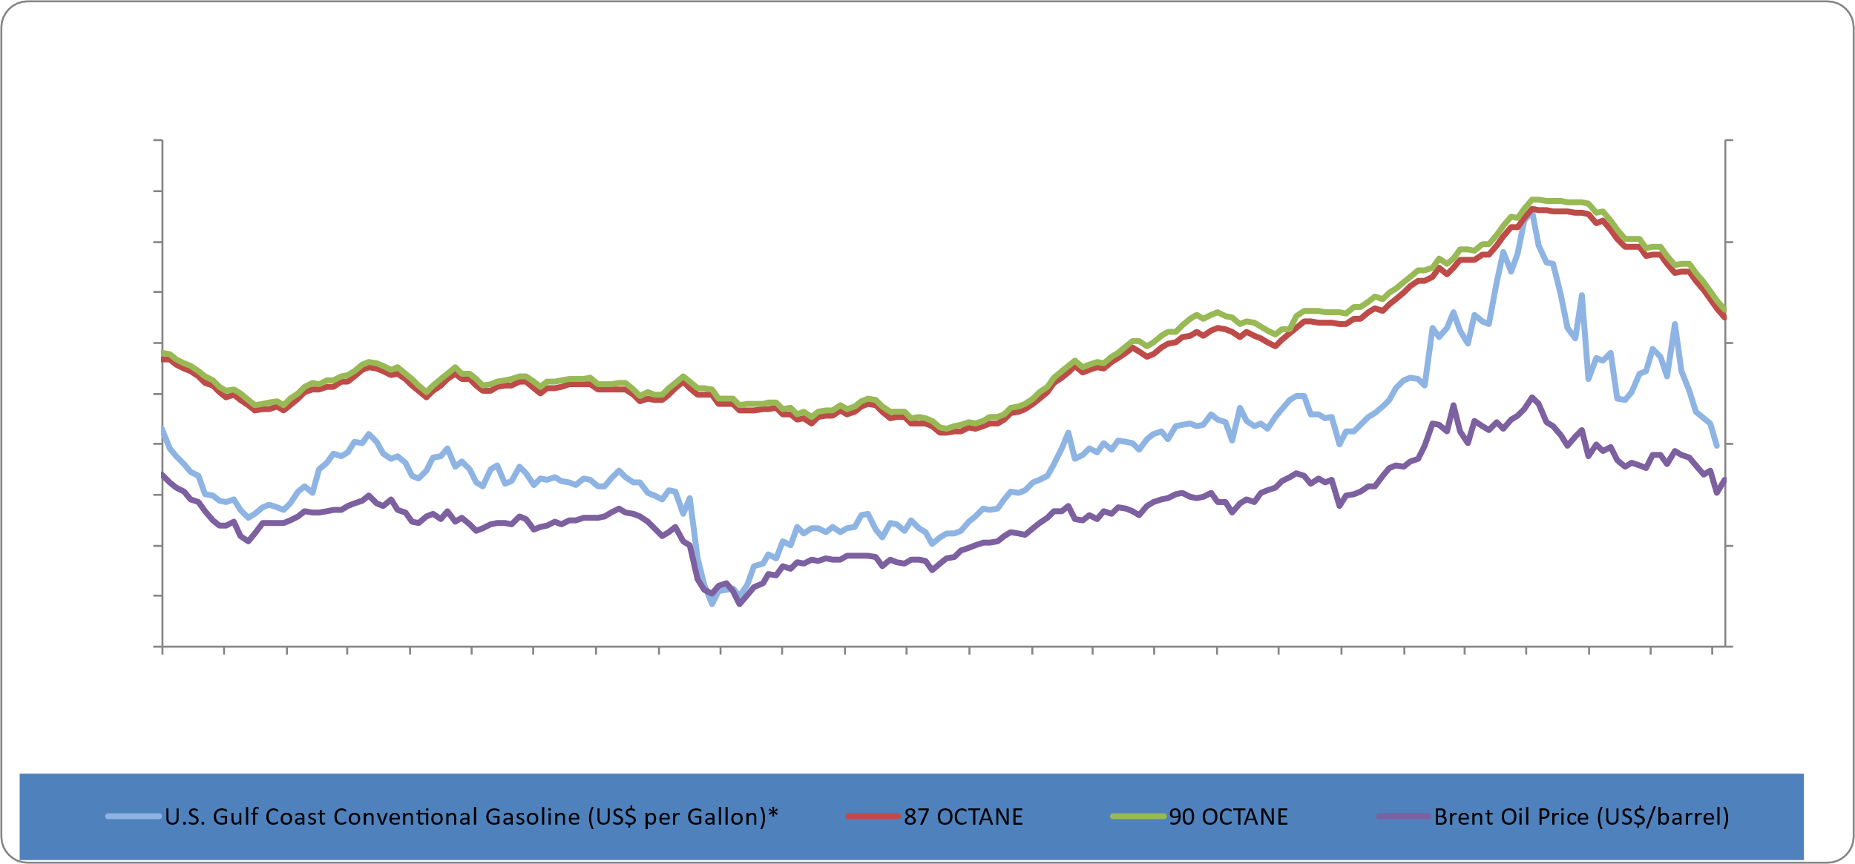
Brent Oil
Brent oil price increased by 8.44% or US$6.43 relative to the prior week. Oil traded on December 15, 2022 at US$82.58 per barrel relative to US$76.15 on December 8, 2022. Brent oil opened 2022 year at US$78.98 per barrel and has increased by US$3.60 (4.56%) year to date.
WEEKLY GAS PRICE REVIEW

Slide 4
This Week in Petroleum
U.S. average regular gasoline and diesel prices decreased
On December 12, 2022, the U.S. average regular gasoline retail price decreased by 15 cents to $3.24 per gallon, $0.08 lower than a year ago. The East Coast price decreased by 13 cents to $3.23 per gallon. The Gulf Coast price decreased by 8 cents to $2.73 per gallon. The West Coast price decreased by 22 cents to $4.15 per gallon. The Midwest price decreased by 18 cents to $3.03 per gallon. The Rocky Mountain price decreased by 18 cents to $3.23 per gallon.
The average diesel fuel price decreased by 21 cents to $4.75 per gallon on December 12, 2022, $1.11 higher than a year ago. The Rocky Mountain price decreased by 22 cents to $5.03 per gallon. The Midwest price decreased by 26 cents to $4.65 per gallon. The East Coast price decreased by 18 cents to $5.01 per gallon. The Gulf Coast price decreased by 18 cents to $4.34 per gallon. The West Coast price decreased by 22 cents to $5.29 per gallon.
WEEKLY GAS PRICE REVIEW

Slide 5
This Week in Petroleum (cont’d)
The Majority of Inventories for Propane/Propylene Increased
There was an increase in U.S. propane/propylene stocks last week by approximately 0.66 million barrels to 90.34 million barrels as of December 9, 2022, approximately 19.47 million barrels more than the average inventory levels a year ago to date.
Additionally, East Coast and Gulf Coast inventories increased 0.13 million barrels and 0.81 million barrels, respectively. While Midwest and Rocky Mountain/West Coast inventories decreased 0.13 million barrels and 0.15 million barrels, respectively. For additional information click the link below:
https://www.eia.gov/petroleum/weekly/propane.php
WEEKLY GAS PRICE REVIEW

