Slide 1





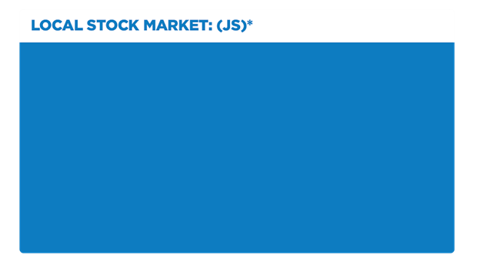


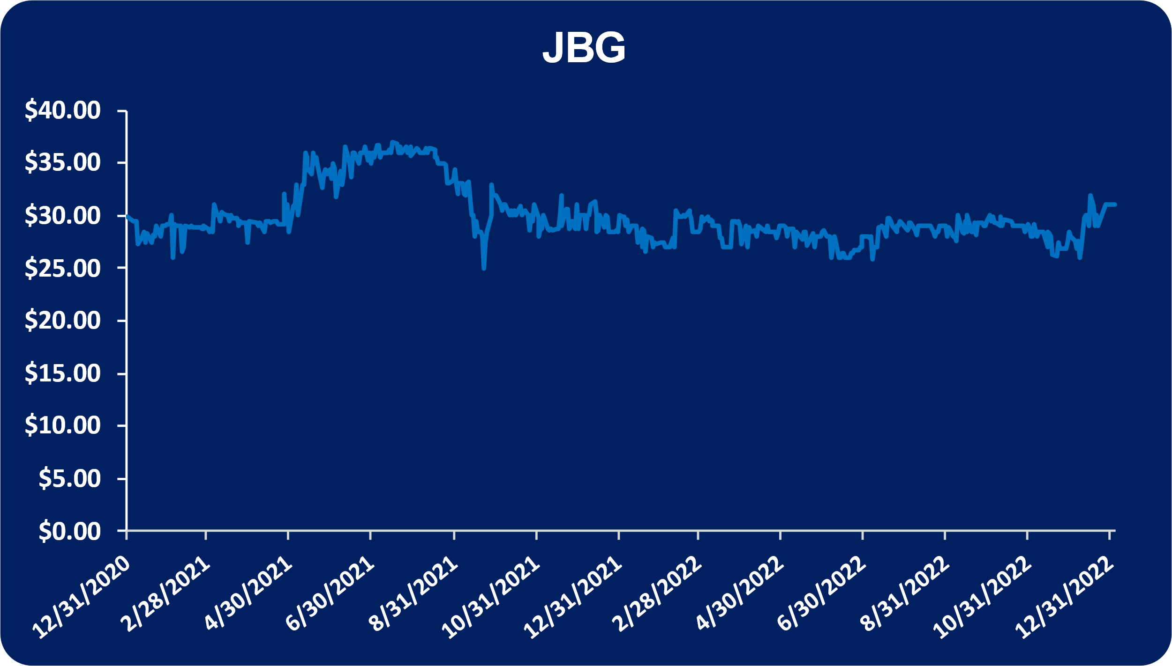


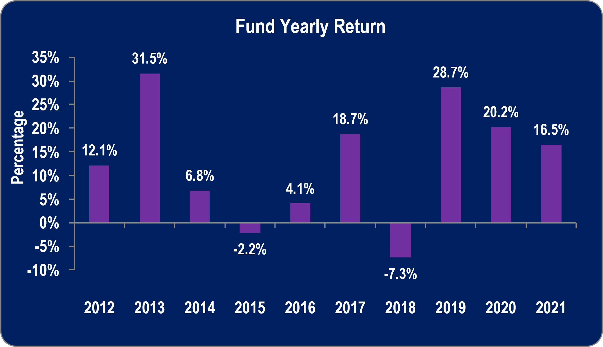
Feb. 23, 2021
January 3, 2022
*Rates as at December 30, 2022
The Jamaican dollar fixed income market was not liquid in today’s (January 3, 2023) trading session. The over night rate stood at 7.75% to 8.00%, while the 30-day rate was 8.50% to 8.65%.
The US dollar fixed income market was also not liquid during today’s (January 3, 2023) trading session. The overnight market rates were quoted at 1.00% to 1.50% while the 30-day market rates stood at 3.80% to 4.00%.
Jamaica Broilers Group (JBG)
Wisynco​ Group Limited (WISYNCO)
For the six months ended October 31, 2022:
JBG reported total revenue of $45.84 billion for the six months ended October 31, 2022 (2021: $35.08 billion), a 31% increase year over year.
Cost of sales increased 25% to $34.75 billion (2021: $27.81 billion). Consequently, gross profit increased 53% to $11.10 billion (2021: $7.27 billion).
Distribution costs increased 18% to $1.44 billion for the period (2021: $1.21 billion), while administration and other expenses increased 22% to $5.48 billion (2021: $4.50 billion). Other income amounted to $265.08 million (2021: $162.71 million), 63% more year over year.
Operating profit increased 159% to $4.45 billion (2021: $1.71 billion).
Finance income declined 74% to $4.48 million (2021: $17.32 million); finance costs increased 41% to $756.49 million (2021: $535.81 million).
Profit before taxation increased 209% to $3.69 billion (2021: $1.20 billion). Taxes payable for the period increased 168% to $671.25 million (2021: $250.45 million). Net profit increased 119% to $1.91 billion (2021: $871.50 million).
Net profit attributable to shareholders amounted to $2.07 billion (2021: $882.14 million), 135% more year over year.
Total comprehensive income for the six months amounted to $2.36 billion (2021: $736.93 million).
Earnings per share (EPS) for period totalled $1.73 (2021: $0.74). The trailing twelve months EPS amounted to $3.60. The total number of shares employed in our calculations amounted to 1,199,276,400 units.
CI Synergy American Corporate Class
This fund invests primarily in equity and equity-related securities of companies which are located in countries that have signed the North American Free Trade Agreement (NAFTA) (or its successor).
The fund has a 3-year return of 5.90% and a 5-year return of 6.80%. The Fund also has a 10-year return of 9.10%. Rates are as at November 30, 2022.
*Prices are as at January 3, 2023 *Projections are made to the company’s financial year end

Slide 2






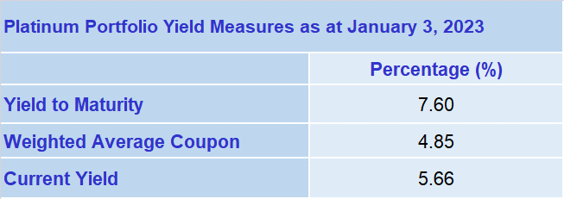
US Recession ‘Pretty Likely,’ Ex-New York Fed Chief Dudley Says
China’s Economy Ends Year in Slump as Covid Infections Surge
A US economic recession is in the cards because of what the Federal Reserve must do to cool inflation, former New York Fed President William Dudley, but it probably won’t be a severe slowdown.
“A recession is pretty likely just because of what the Fed has to do,” he said in an interview on Bloomberg Surveillance Tuesday. “But what’s different this time I think is that if we have a recession, it’s going to be a Fed-induced recession and the Fed can end the recession by subsequently easing monetary policy.”
https://www.bloomberg.com/news/articles/2023-01-03/us-recession-pretty-likely-ex-new-york-fed-chief-dudley-says
China’s economy ended the year in a major slump as business and consumer spending plunged in December, with more disruption likely in the first few months of the year as Covid infections surge across the country.
Official data over the weekend showed the decline in manufacturing worsened last month, while activity in the services sector plunged the most since February 2020.
https://www.bloomberg.com/news/articles/2023-01-02/china-s-economy-ends-year-in-slump-as-covid-infections-surge
USD Money Market
This portfolio is a full discretionary managed bond portfolio, ideal for clients who have short term USD liquidity needs Assets within the portfolio can be used as collateral for loans The product provides a solid short term investment option in hard currency and allows the individual to hedge against the prevailing devaluation in the local currency
The platinum portfolio has an effective maturity of 9.61 years and duration of 5.58 years.
Analyst Certification - The views expressed in this research report accurately reflect the personal views of Mayberry Investments Limited Research Department about those issuer (s) or securities as at the date of this report. Each research analyst (s) also certify that no part of their compensation was, is, or will be, directly or indirectly, related to the specific recommendation (s) or view (s) expressed by that research analyst in this research report.
Company Disclosure - The information contained herein has been obtained from sources believed to be reliable, however its accuracy and completeness cannot be guaranteed. You are hereby notified that any disclosure, copying, distribution or taking any action in reliance on the contents of this information is strictly prohibited and may be unlawful. Mayberry may affect transactions or have positions in securities mentioned herein. In addition, employees of Mayberry may have positions and effect transactions in the securities mentioned herein.
MIL Ratings System:
BUY: We believe the stock is attractively valued. The company has sound or improving fundamentals that should allow it to outperform the broader market. We anticipate the stock will outperform the market over the next 12 months. The risk factors to achieving price targets are minimal.
HOLD: We believe the stock is fairly valued at the current price. The company may have issues affecting fundamentals that could take some time to resolve. Alternatively, company fundamentals may be sound, but this is fully reflected in the current stock price. The risk factors to achieving price targets are moderate. Some volatility is expected. In addition, technically it may be difficult to attain additional volume of the stock(s) at current price.
SELL: We believe the stock is overpriced relative to the soundness of the company’s fundamentals and long-term prospects.
SPECULATIVE BUY: We believe the prospects for capital appreciation exist, however there is some level of uncertainty in revenue growth.
Source: www.jamstockex.com, www.bloomberg.com, www.investopedia.com, www.tradewire.com

